Slide 1
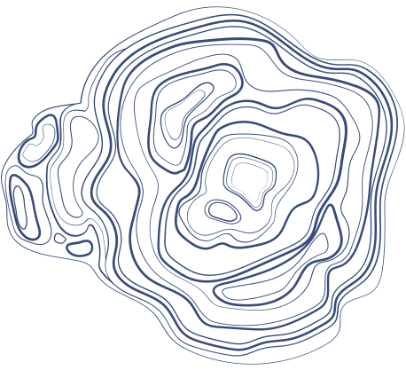



BANKRUPTCY PROJECT
Presented By Group 2

Slide 2



OUR TEAM
1. Bhavana Kurabet
2. Mahesh Ushir
3. Megha Kerur
4. Nikita Khalane
5. Niveditha KO
6. Sahana Motalli
7. Suhana Shaik

Slide 3



PROBLEM
There are 6 independent variables given and one target variable. Using these varibles the goal of the project is to predict whether a company is going to go bankrupt or not. The data file contained 7 features about 250 companies. The variables were industrial risk, operating risk, management risk, credibility, competitiveness, financial flexibility and class (bankruptcy or non bankruptcy)

Slide 4


INTRODUCTION
Objective: To predict bankruptcy using financial data.
Dataset: Financial data of companies.
Tools Used: Python, Pandas, Scikit-learn, Numpy, Matplotlib, seaborn, sklearn

Slide 5


DATA PREPROCESSING
Loading Data:
Imported the dataset using Pandas.
Missing Values:
Checked for missing values using isnull().sum().
Imputed missing values using the median for numerical features.
Feature Selection:
Identified relevant features using correlation analysis.
Removed features with low variance.
Data Scaling:
Applied StandardScaler to normalize the feature values for better model performance.

Slide 6

EXPLORATORY DATA ANALYSIS
Distribution Analysis:
Plotted histograms and boxplots to understand the distribution of features.
Identified outliers and their potential impact on the model.
Correlation Analysis:
Used a heatmap to visualize the correlation between features.
Identified highly correlated features to avoid multicollinearity.
Target Variable Analysis:
Visualized the distribution of the target variable (bankruptcy vs. non-bankruptcy).

Slide 7

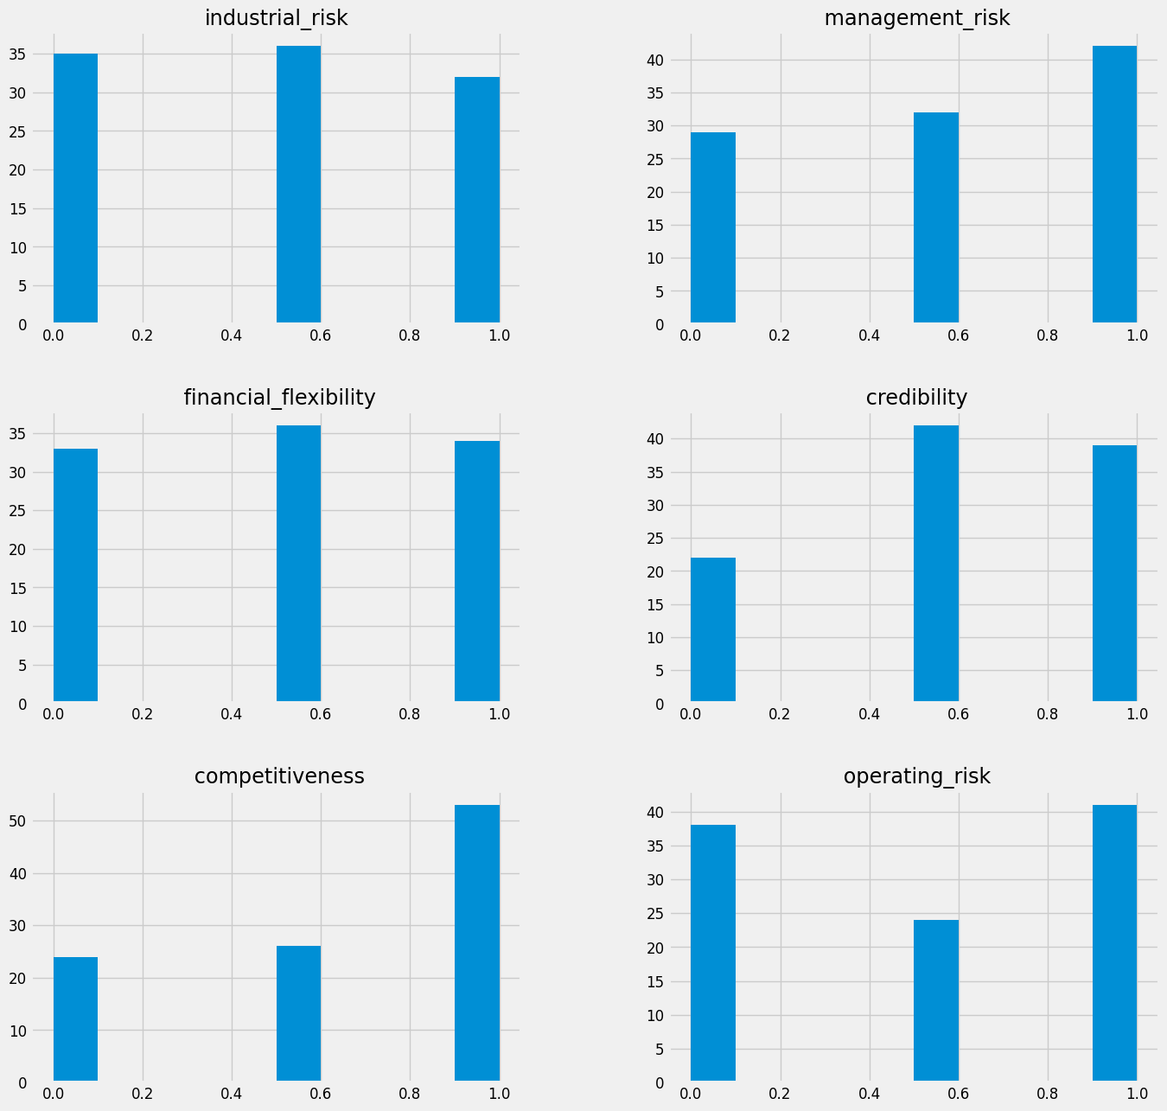

Slide 8

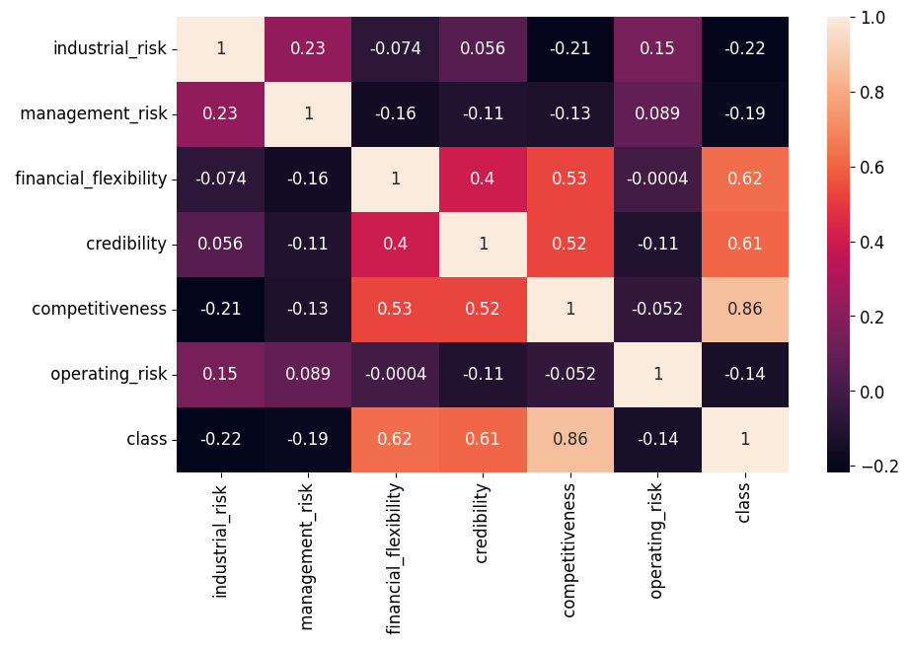
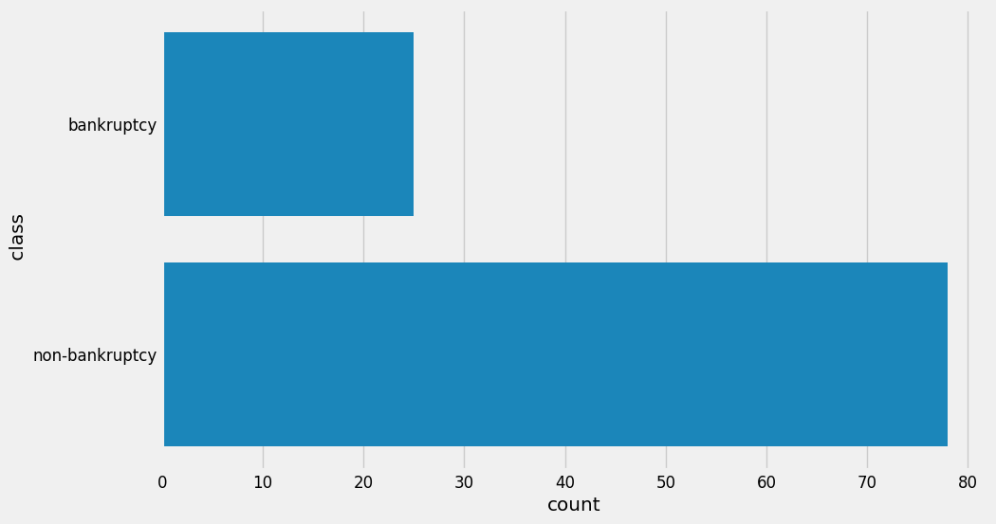
GRAPHS

Slide 9

MODEL SELECTION
Logistic Regression: Simple and interpretable.
Random Forest: Handles non-linear relationships and provides feature importance.
Naive Bayes: Based on probabilistic approach.
Gradient Boosting: Combines weak learners to form a strong predictive model.
Support Vector Machine (SVM): Effective in high-dimensional spaces.
K-Nearest Neighbors (KNN): Simple and instance-based learning.

Slide 10


LOGISTIC REGRESSION
Split data into training (80%) and testing (20%) sets using train_test_split.
Accuracy: Calculated using accuracy_score.
Confusion Matrix: Visualized using a heatmap to understand true/false positives and negatives.
Classification Report: Precision, Recall, F1-score for each class.

Slide 11
RANDOM FOREST
Evaluation:
Accuracy and confusion matrix analysis.
Feature Importance: Plotted the importance of each feature in predicting bankruptcy.
Performance:
Showed high accuracy and balanced performance across metrics.

Slide 12
NAIVE BAYES
Training:
Trained the Naive Bayes model using GaussianNB.
Evaluation:
Accuracy: 95.24%
Confusion Matrix: Visualized using a heatmap.
Classification Report: Highlighted the precision, recall, and F1-score for each class.
Observed high precision and recall for class 1 (non-bankrupt).

Slide 13
GRADIENT BOOSTING
Training:
Trained the Gradient Boosting model on the training set.
Evaluation:
Accuracy: Calculated using accuracy_score.
Confusion Matrix and Classification Report: Detailed performance metrics.
Performance:
Showed the highest accuracy and well-balanced precision/recall among all models.

Slide 14
SUPPORT VECTOR MACHINE
(SVM)
Training:
Split data into training (80%) and testing (20%) sets using train_test_split.
Trained the SVM model using SVC.
Evaluation:
Accuracy: Calculated using accuracy_score.
Confusion Matrix: Visualized using a heatmap to understand true/false positives and negatives.
Classification Report: Precision, Recall, F1-score for each class.

Slide 15

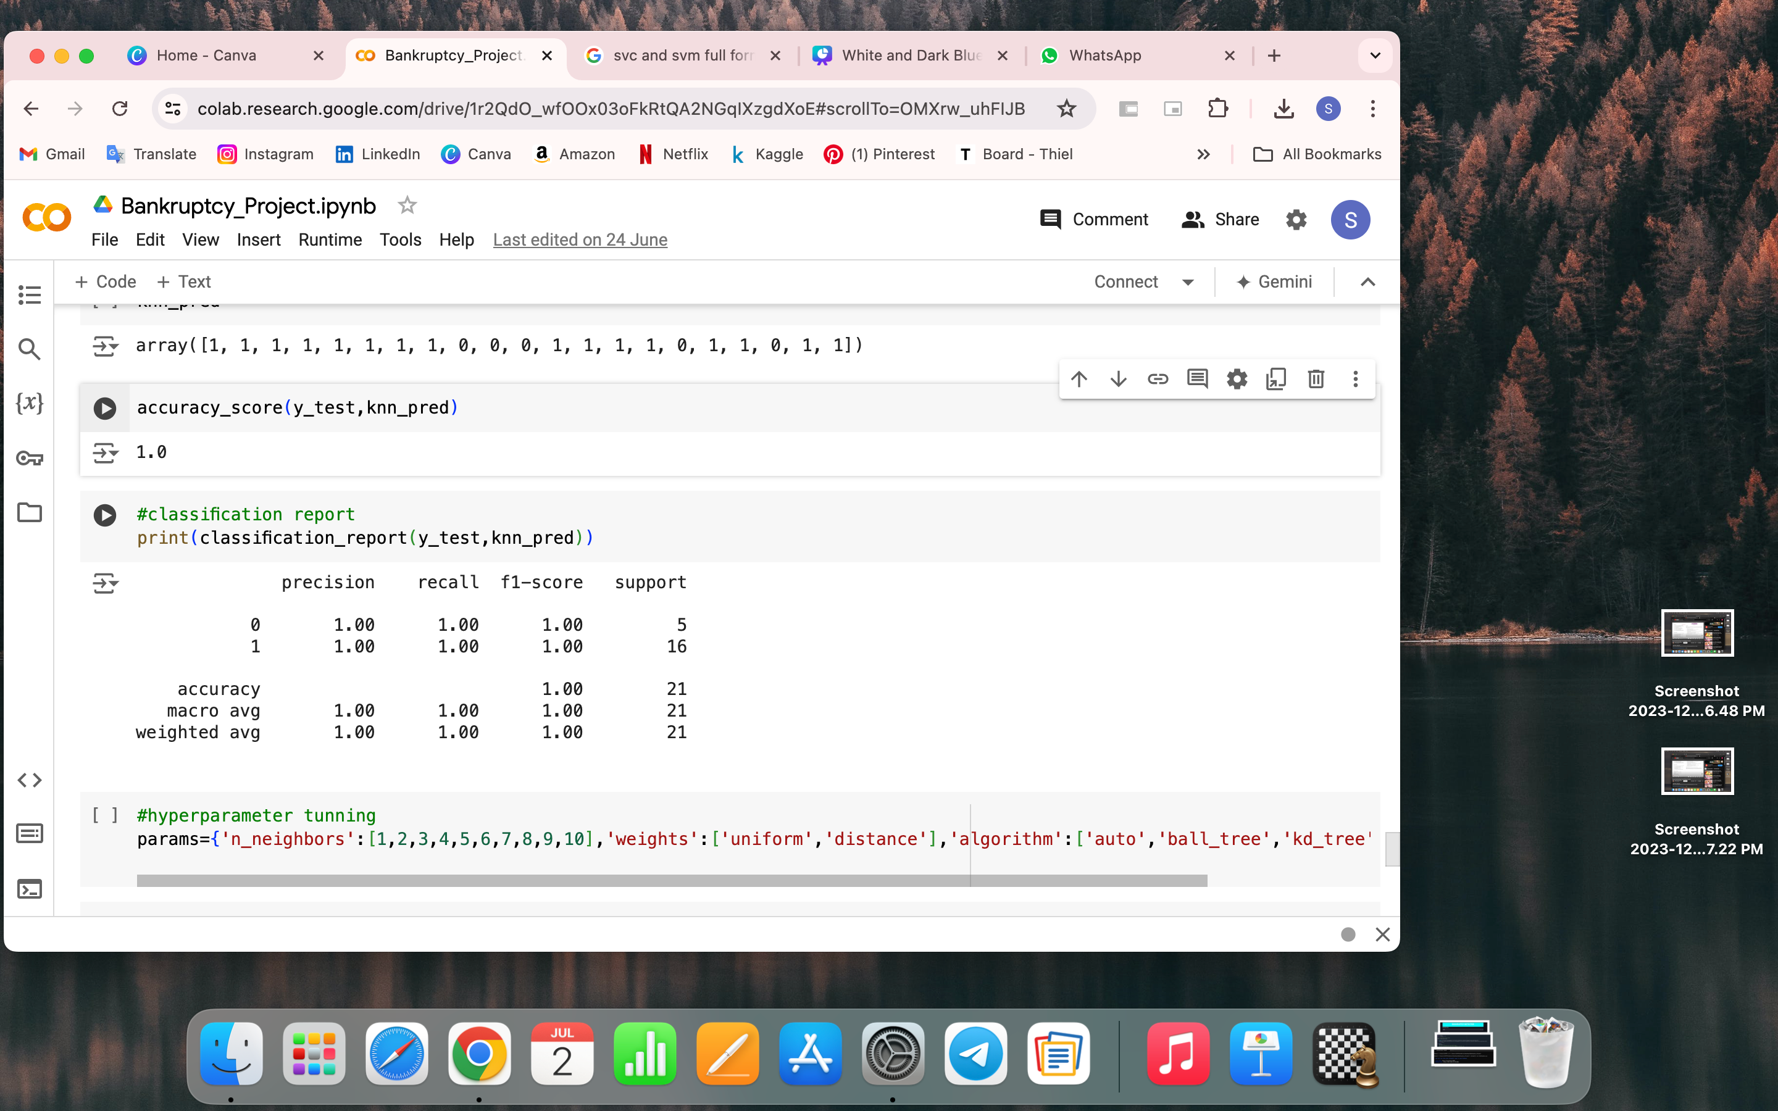

K-NEAREST
NEIGHBORS(KNN)
Training:
Trained the KNN model using KNeighborsClassifier with k=5.
Evaluation:
Accuracy: Calculated using accuracy_score.
Confusion Matrix: Visualized using a heatmap.
Classification Report: Detailed precision, recall, and F1-score for each class.

Slide 16

MODEL COMPARISON
Metrics Comparison:
Created a table comparing accuracy, precision, recall, and F1-score for all models.
Best Model:
Support Vector Classifier(SVC) with the highest overall accuracy and balanced performance.
Insights:
Support Vector Classifier(SVC), Random Forest and Gradient Boosting performed well due to their ability to handle complex relationships in the data.

Slide 17
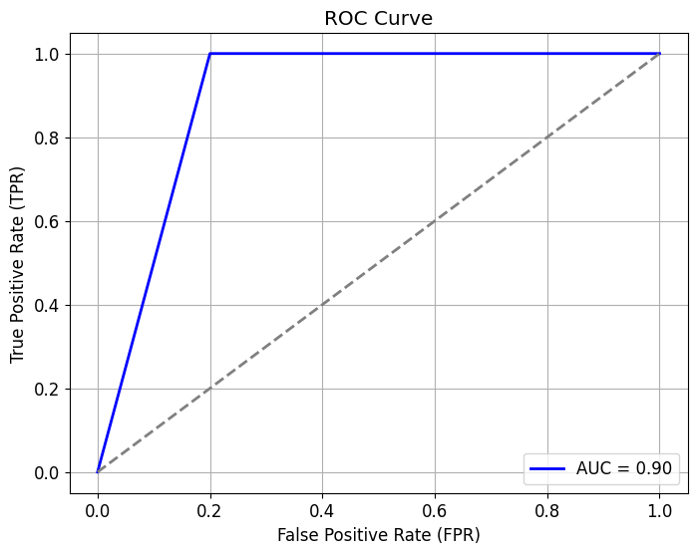
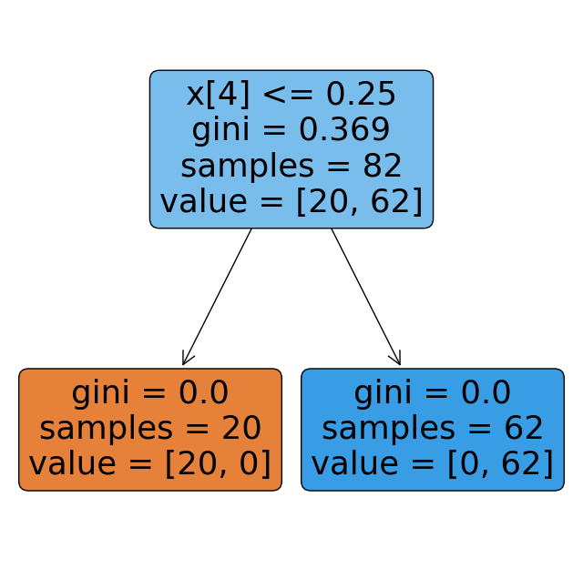
GRAPHS
LOGISTIC REGRESSION
DECISION TREE

Slide 18
DEPLOYMENT
Model used: Support Vector Classifier.
Pickle file generated in Jupyter notebook.
Downloaded the pickle file and transferred it into a separate deployment folder.
Moved the file into Spyder.
Saved the file and ran source file in anaconda prompt.
Deployed the model on streamlit.

Slide 19
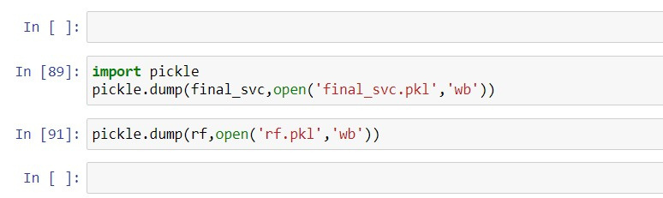

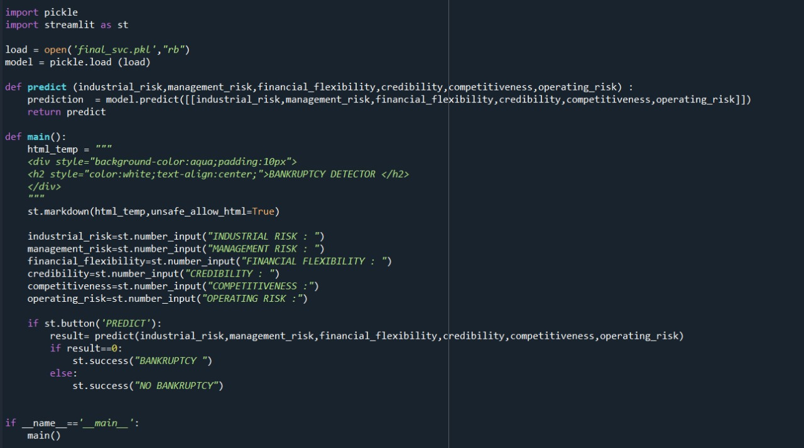

code to generate pickle file
Spyder code

Slide 20
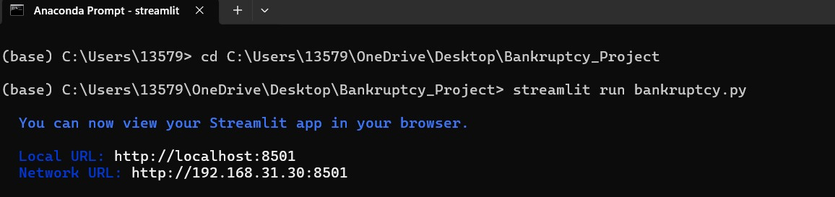
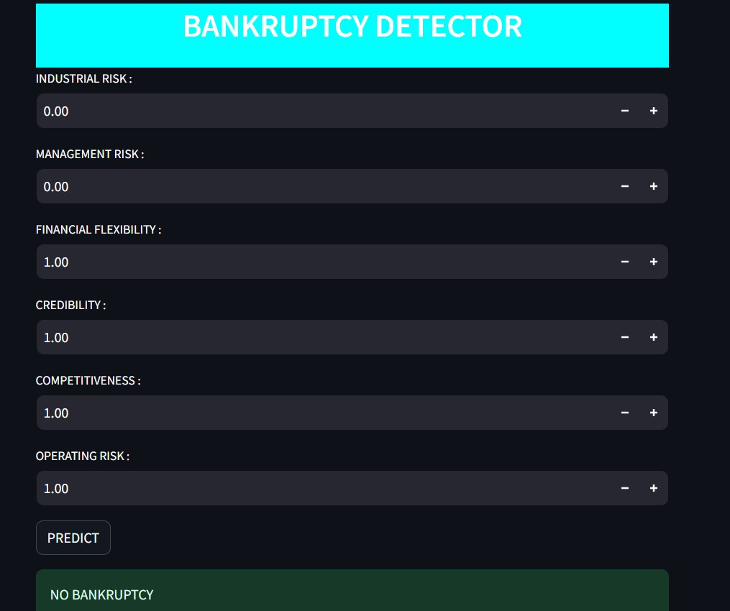
Anaconda prompt
Deployment window

Slide 21
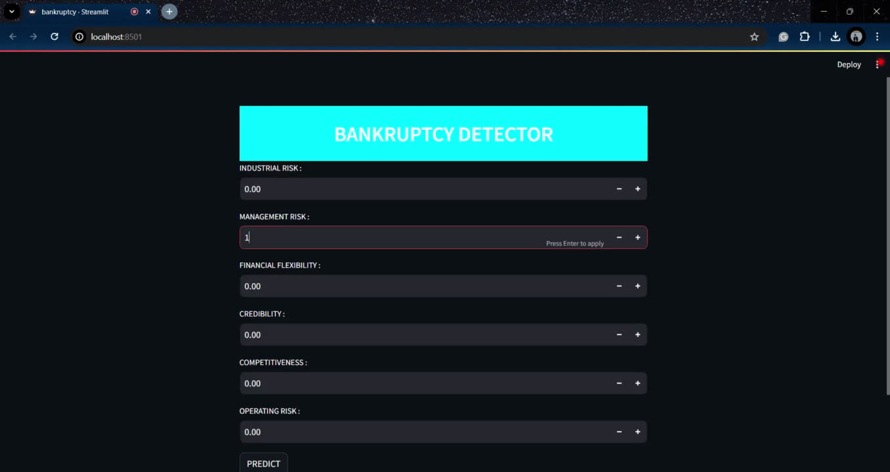
DEPLOYMENT

Slide 22

Thank You

